Slide 1

ACPS Cultural Competency Framework and Commitment
Building Coherence Across Teaching, Leadership, and Operations
Expanding alignment, role clarity, and sustainable implementation
Ayanna Mitchell
Department of Instruction
Albemarle County Public Schools

Slide 2



Strategic Plan: Learning for All
VALUES
Equity
Excellence
Family and Community
Wellness
GOALS
Thriving Students
Affirming and Empowering Communities
Equitable, Transformative Resources
VISION
Our learners are engaged in authentic, challenging, and relevant learning experiences, becoming lifelong contributors and leaders in our dynamic and diverse society.
MISSION
Working together as a team, we will end the predictive value of race, class, gender, and special capacities for our children’s success through high-quality teaching and learning for all. We seek to build relationships with families and communities to ensure that every student succeeds.
We will know every student.

Slide 3
State Requirements and Division Responsibility
Key Legal Requirements
Training Requirements:
• Required every two years
• Required for licensure renewal
Evaluation Expectations:
• Inclusive learning environments
• Equitable instructional practices
Division Responsibility:
• Local implementation
• Ongoing professional learning
• Systems alignment
Virginia law requires school divisions to provide cultural competency training for all licensed staff at least every two years. The Virginia Board of Education defines the required cultural competencies and training expectations, while local school boards are responsible for approving and implementing aligned professional learning and evaluation practices within their divisions.
Code of Virginia § 22.1-298.7; Virginia Department of Education Cultural Competency Training Guidance (HB1904/SB1196).
“ACPS must move beyond isolated training experiences toward sustainable implementation across the division.”

Slide 4

“Virginia’s Four Cultural Competency Domains”
Self-Reflection
Instructional Practices
Learning Environments
Community Engagement
These domains provide the foundation for ACPS’s local framework development.

Slide 5
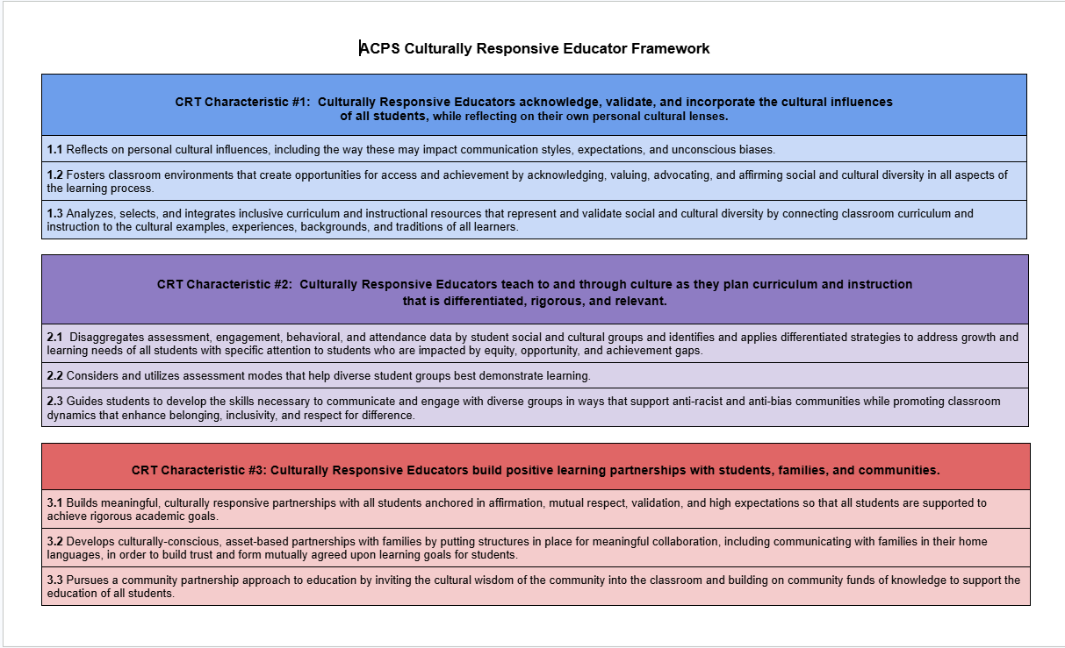
2021-2026 ACPS Culturally Responsive Educator Adopted Framework
Current Implementation (2021–2026)
• Book study model
• Micro-credential pathway
• Schoology modules
• Reflection artifacts
• Teacher-focused implementation

Slide 6
Why Expand the Current Model?
Current Strengths
Shared foundational understanding
Strong educator engagement
Established credentialing structure
Division-wide participation
Current Gaps
Primarily educator-focused
Limited role-specific application
Inconsistent implementation across departments
Limited operational integration
Expanding the current model strengthens how ACPS operationalizes its commitment to ‘end the predictive value of race, class, gender, and special capacities for children’s success’ through aligned expectations, role-specific supports, and sustainable implementation across the division.

Slide 7
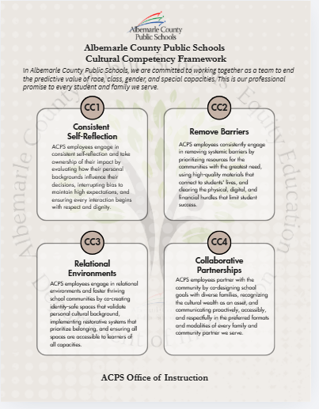
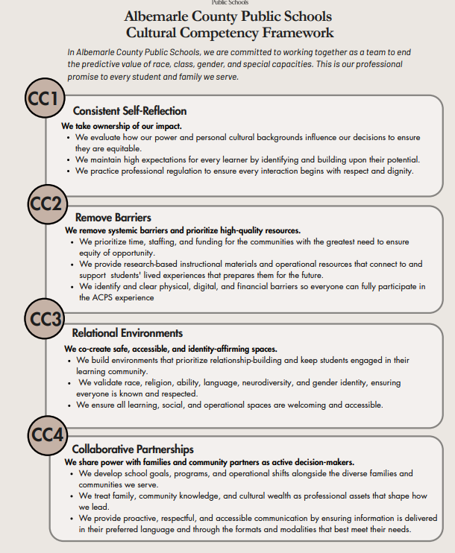
Proposed Unified Cultural Competency Framework
One aligned framework with role-specific indicators for educators, leaders, operations, and technology staff.
Purpose:
• Shared expectations
• Consistent language
• Role-specific application
• Sustainable implementation

Slide 8
Role Specific Indicators In Practice
Leaders | Educators | Operations | Technology
•Equity-centered decision-making • Inclusive supervision • Data-informed leadership | • Inclusive instructional design • Student engagement • Relationship-centered learning | •Family-centered systems • Accessible processes • Responsive service practices | • Digital accessibility • Equitable access • Inclusive communication systems

Slide 9
Differentiated Professional Learning Model
Foundational Learning
Coaching
Cohorts
Embedded indicators
Applied Learning
Coaching
Workshops
Department implementation
Sustained Learning
Certification
Reflection
Continuous improvement
The goal is not one-time training, but ongoing integration into daily practice.

Slide 10
Current Participation
ACPS Staff Hired by 2024:
Book Study Completion: 1262
Microcredential Completion: 705
Microcredential in progress:557
Staff Completion (25-26)
85 staff completed Book Study (25-26)
241 staff completed Micro-Credentialing (25-26)
New Certification pathway currently in pilot implementation (3 Participants)
Key Opportunity
• Strengthen coherence across systems
• Clarify expectations across roles
• Expand implementation beyond instruction
• Build sustainable division-wide structures

Slide 11
Questions/Discussion

